Slide 1



WORLD DEVELOPMENT MEASUREMENT
Presented by Group - 06

Slide 2
Project Flow
1
Objective
2
Exploratory Data Analysis
3
Model Building
4
Model Evaluation
5
Deployment

Slide 3



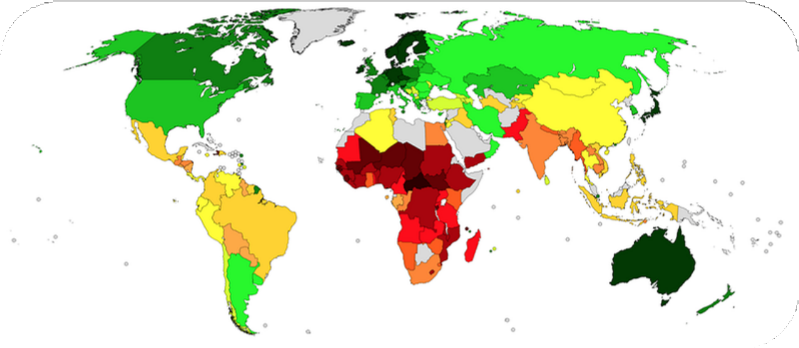

Objective
Business objective:
To analyse and create clusters on the dataset which contains data on significant economic and development measures pretaining to various nations worldwide.

Slide 4
Exploratory Data Analysis (EDA)
Check for Null Values and Dulpicates We found that there are 18.7% non- null values and 81.3% null values.
Data Type Validation
Before handling null values, we need to make sure that data types are validated.
Convert non numeric columns ‘Business Tax Rate’, ‘Country’, ‘GDP’, ‘Health Exp/Capita’, ‘Tourism Inbound’ and ‘Tourism Outbound’ into numeric.
Handling the Null Values
Check for the skewness and use KNN Imputer if not highly skewed and doesnot have outlier.
Fill with the median if there is any outlier.
Handling the Outliers
We tried to cap the outliers using the quantile infomation of the data.

Slide 5
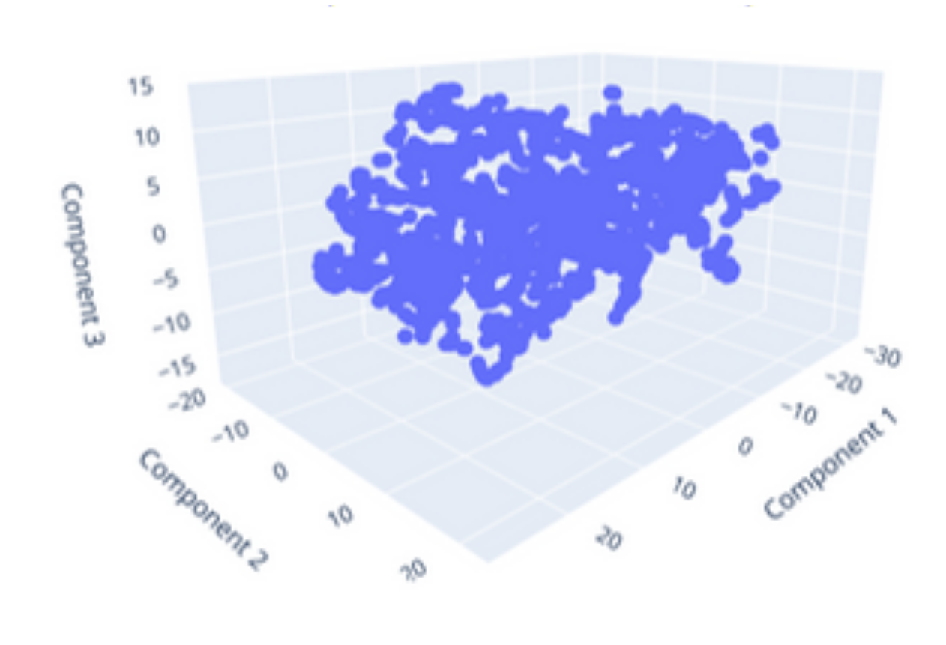
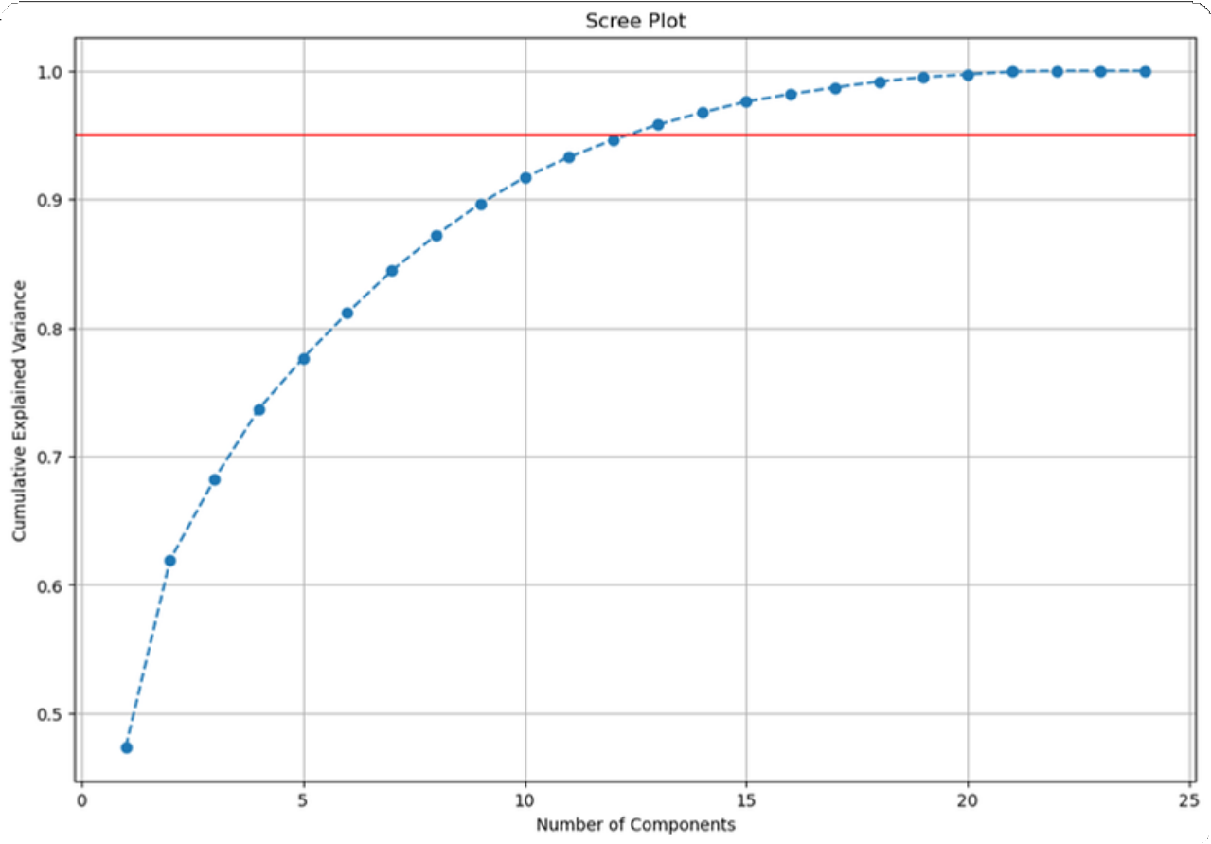
Used T-SNE and PCA to Reduce Dimensionality of the data for visualization
T-SNE PCA
Red line shows 95% of variance threshold

Slide 6
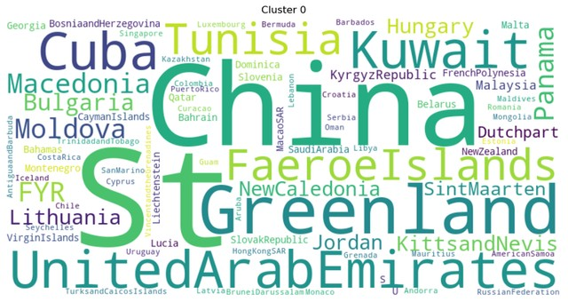
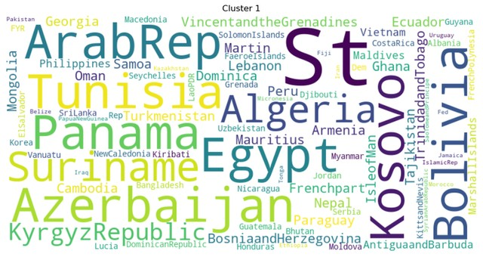
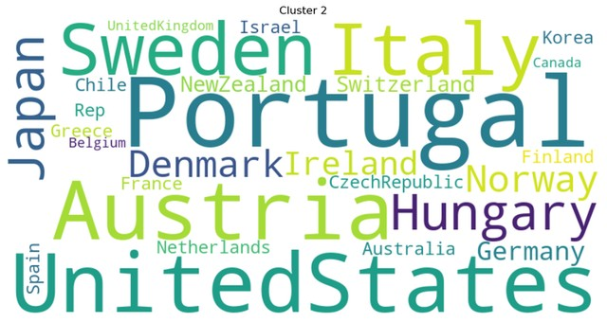
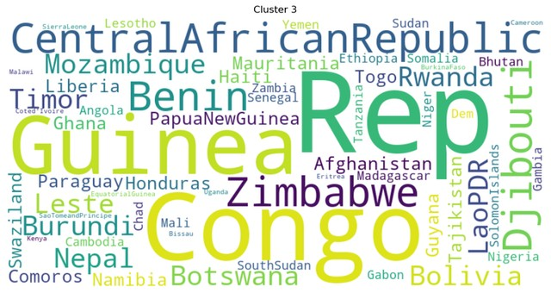
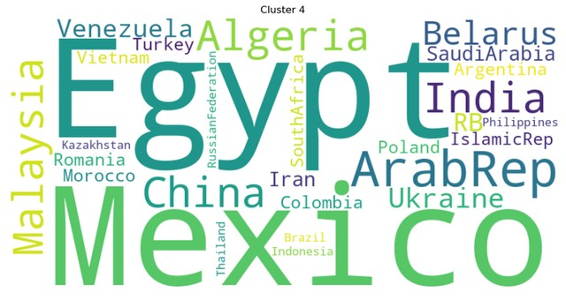
From the dendogram we found that the ideal number of clusters we can form is 5
Cluster - 0 Cluster - 1 Cluster - 2
Cluster - 3
Cluster - 4
Also performed Multivariate and Univariate analysis of clusters

Slide 7


Modeling
We used ML Packages like Scikit-learn and Catboost to build Machine Learning Classification Models.
Clustering algorithms used are:
Hierarchical Cluster
K-Means Cluster
DBSCAN Cluster HDBSCAN Cluster
Classification algorithms used are:
Random forest
Linear SVC
KNN
Adaboost Catboost SGD

Slide 8

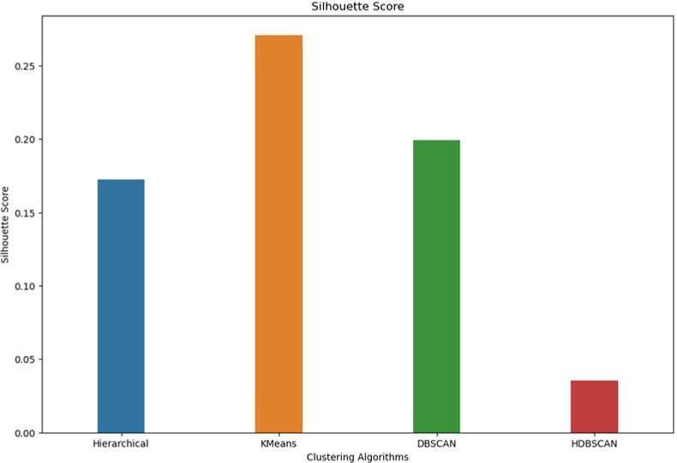
Evaluation
Silhouette score is used to evaluate Cluster algorithms
KMeans has best Silhouette score and is preferably better algorithm to use

Slide 9
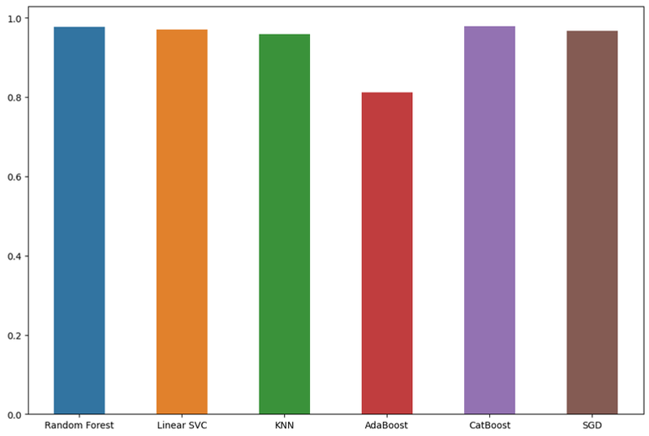
Bar plot for analysing the Classification algorithms
CatBoost performs best with 97% accuracy

Slide 10




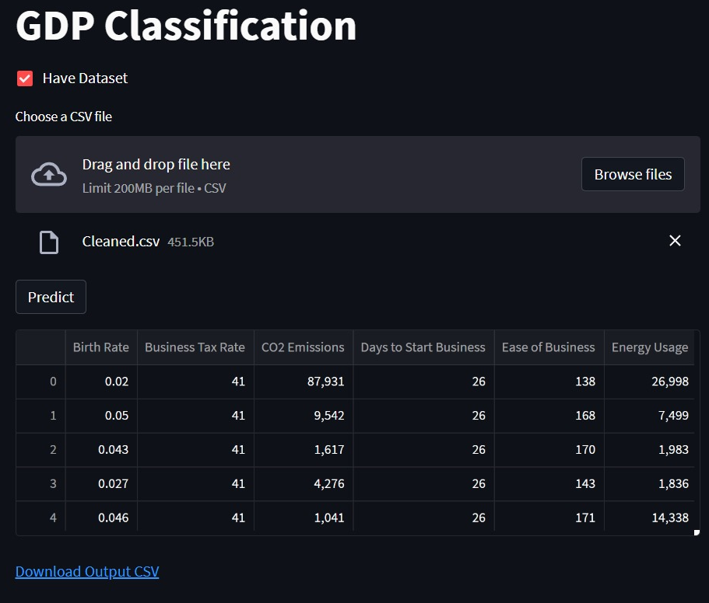
For the Deployment we used Streamlit which gives us simple, easy-to-write script to construct a minimal web page.
Deployment
By uploading the dataset

Slide 11
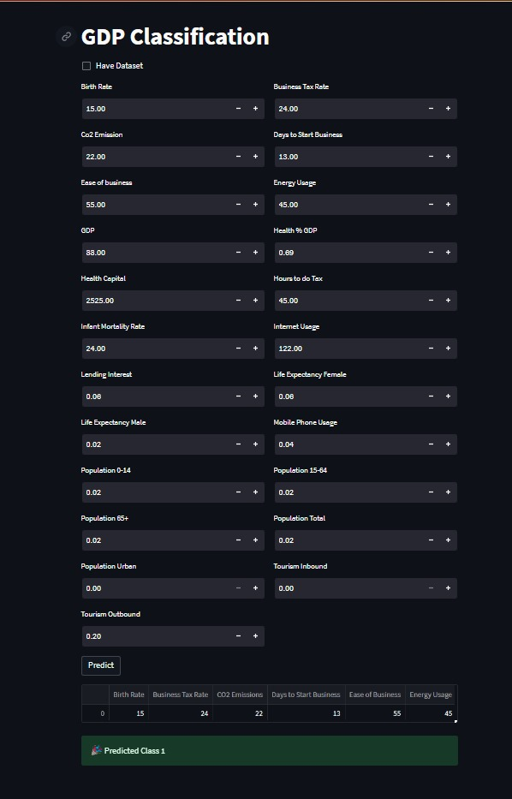

Deployment Snapshots
*By providing values for each

Slide 12

THANK YOU

